Slide 1

Walmart Sales Forecast
Insight into Walmart Sales
Notes:
Erica

Slide 2

Past Sales

Slide 3

Introduce Dataset
Includes:
45 stores
2010-2012 Weekly Sales Data
Other Data: 2010-2014
Temperature - average regional temperature
Fuel Price - regional cost of fuel
CPI - consumer price index
Unemployment - unemployment rate

Slide 4
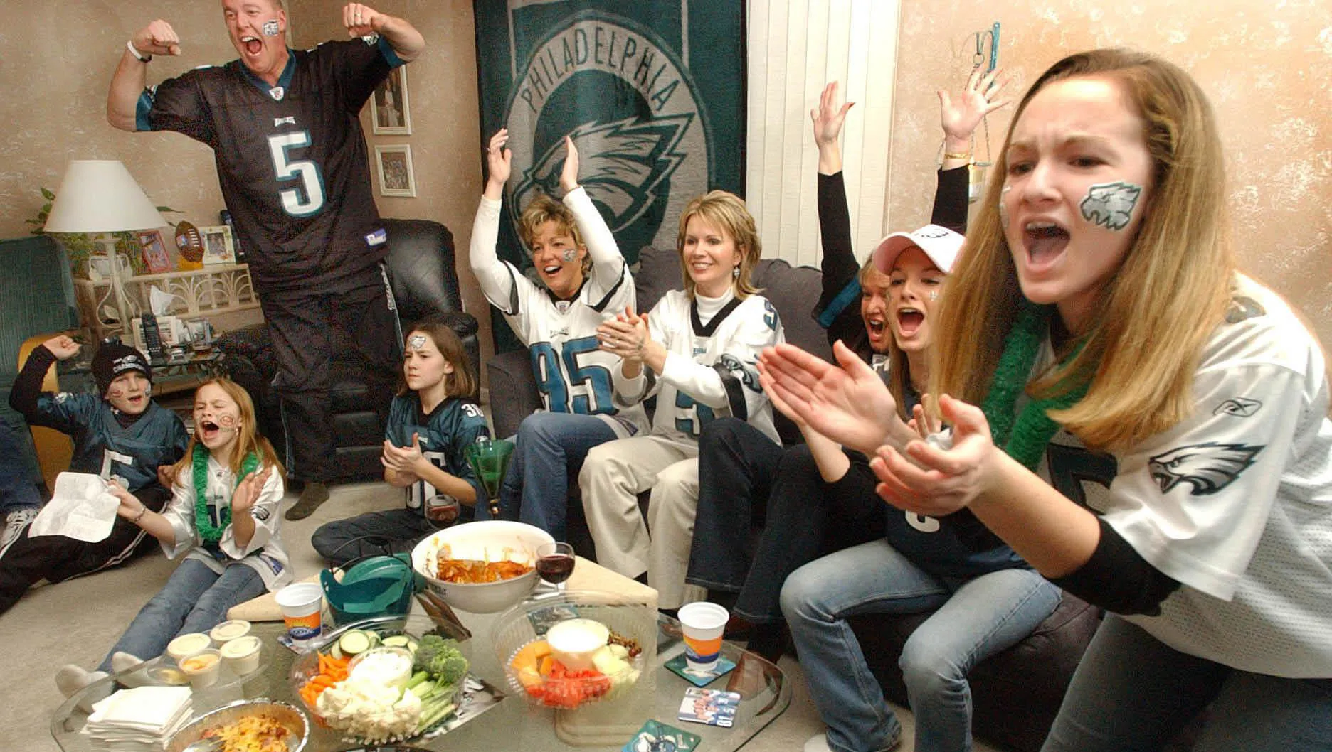


Past Holiday Sales
Super Bowl
Labor Day (Back to School)
Thanksgiving
Christmas

Slide 5

Average Holiday Sales
Compared against weekly average sales.
Which holiday wins for highest sales?
Super Bowl
Labor Day
Thanksgiving
Christmas

Slide 6
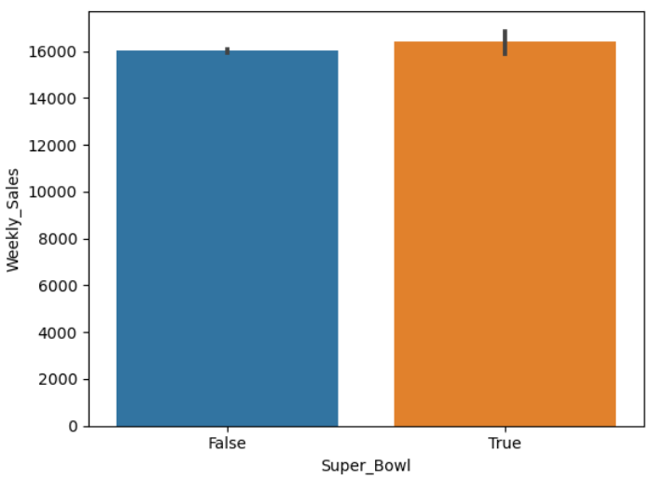
Average Holiday Sales
Compared against weekly average sales.
Which holiday wins for highest sales?
Super Bowl
Labor Day
Thanksgiving
Christmas

Slide 7
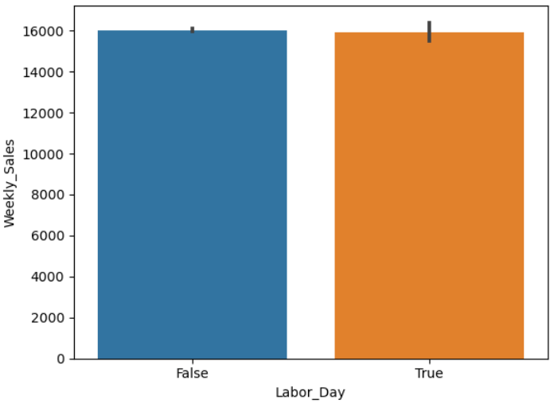
Total Sales Per Holiday
Compared against weekly average sales.
Which holiday wins for highest sales?
Super Bowl
Labor Day
Thanksgiving
Christmas

Slide 8
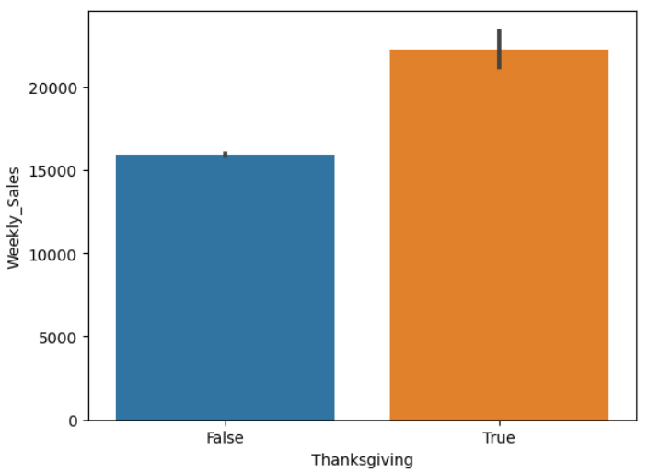
Total Sales Per Holiday
Compared against weekly average sales.
Which holiday wins for highest sales?
Super Bowl
Labor Day
Thanksgiving
Christmas
Notes:
Will Christmas be more than Thanksgiving? Ask the class to guess.

Slide 9
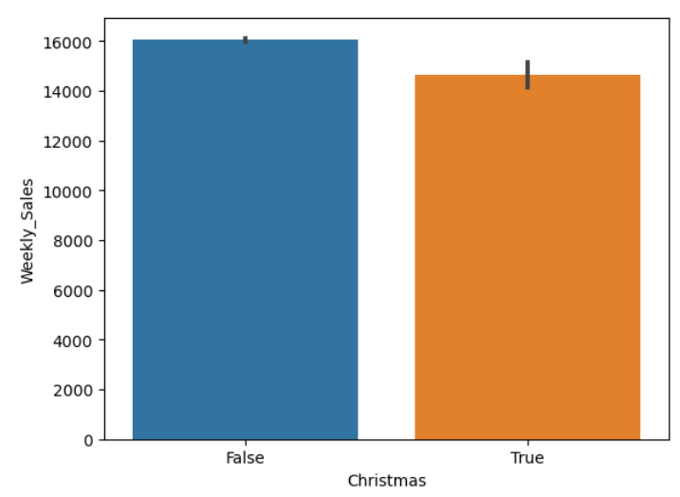
Total Sales Per Holiday
Compared against weekly average sales.
Which holiday wins for highest sales?
Super Bowl
Labor Day
Thanksgiving
Christmas

Slide 10

Thanksgiving
Wins!

Slide 11
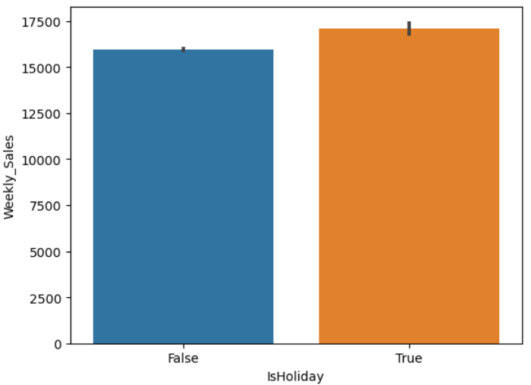
Average Sales
Vs.
Average Holiday Sales
Notes:
Not a remarkable difference between the average weekly sales and average overall holiday sales. Shows what a difference Thanksgiving makes.

Slide 12

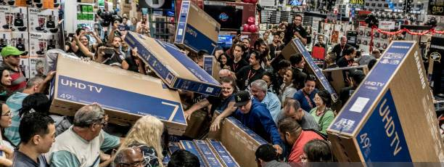
Black Friday
is called black for a reason.

Slide 13

Sales Data Analysis
Using the past to project the future
1 indicates a perfect positive correlation (as one variable increases, the other variable also increases linearly).
-1 indicates a perfect negative correlation (as one variable increases, the other variable decreases linearly).
0 indicates no correlation (the variables are not linearly related).
Notes:
David

Slide 14
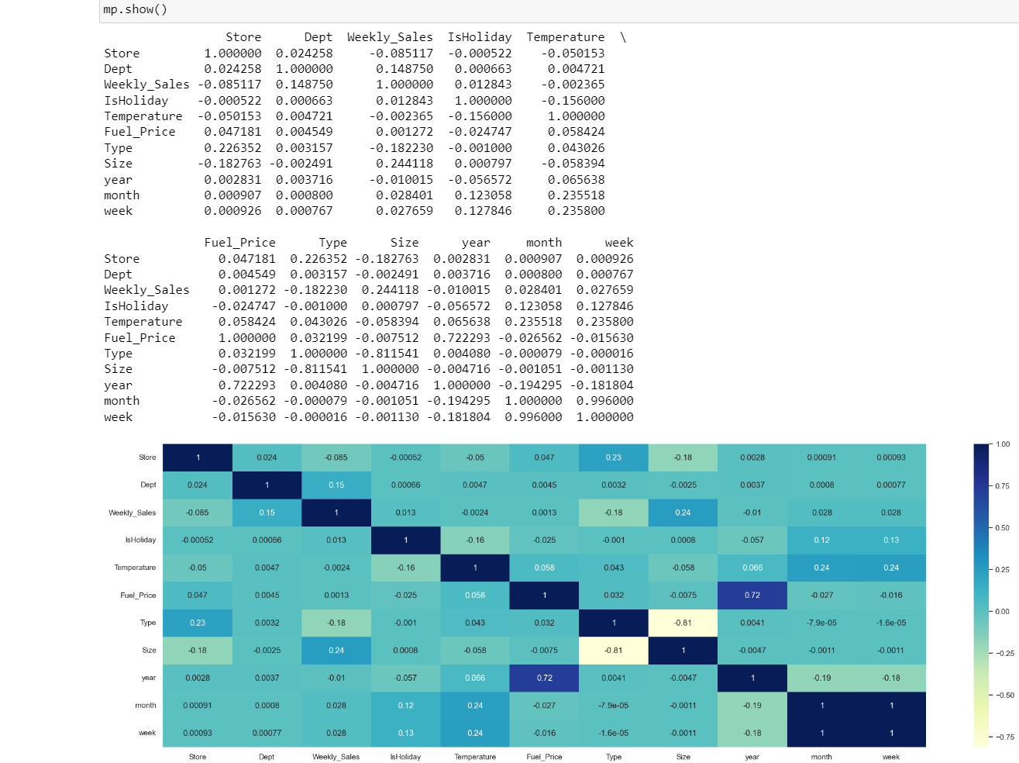
1. Store & Dept: These columns have a very low correlation coefficient of 0.024, indicating a weak positive correlation. It suggests that there's a slight tendency for certain stores to have specific departments, but the correlation is not significant.
2. Store & Weekly_Sales: The correlation coefficient is -0.085, which indicates a weak negative correlation. This suggests that there's a slight tendency for larger stores to have slightly lower weekly sales, but again, the correlation is not strong.
3. Dept & Weekly_Sales: This correlation coefficient is 0.149, indicating a weak positive correlation. It suggests that certain departments may contribute slightly more to weekly sales than others, but the correlation is not very strong.
Notes:
Not a remarkable difference between the average weekly sales and average overall holiday sales. Shows what a difference Thanksgiving makes.

Slide 15
4. IsHoliday & Weekly_Sales: The correlation coefficient is 0.013, which indicates a very weak positive correlation. This suggests that there's a very slight increase in weekly sales during holidays, but the effect is minimal.
5. Temperature & Weekly_Sales: The correlation coefficient is -0.002, indicating almost no correlation between temperature and weekly sales. Changes in temperature do not significantly affect weekly sales in this dataset.
6. Fuel_Price & Weekly_Sales: The correlation coefficient is 0.001, indicating almost no correlation between fuel prices and weekly sales. Changes in fuel prices do not significantly affect weekly sales in this dataset.
Notes:
Not a remarkable difference between the average weekly sales and average overall holiday sales. Shows what a difference Thanksgiving makes.

Slide 16
7. Type & Weekly_Sales: The correlation coefficient is -0.182, indicating a weak negative correlation. This suggests that certain types of stores (e.g., A, B, or C) may have slightly different effects on weekly sales, but the correlation is not very strong.
8. Size & Weekly_Sales: The correlation coefficient is 0.244, indicating a moderate positive correlation. This suggests that larger stores tend to have higher weekly sales, and the correlation is more noticeable compared to other columns.
9. Year & Weekly_Sales: The correlation coefficient is -0.010, indicating almost no correlation between the year and weekly sales. Changes in years do not significantly affect weekly sales in this dataset.
Notes:
Not a remarkable difference between the average weekly sales and average overall holiday sales. Shows what a difference Thanksgiving makes.

Slide 17
10. Month & Weekly_Sales: The correlation coefficient is 0.028, indicating a very weak positive correlation. This suggests that certain months may have slightly higher weekly sales than others, but the effect is minimal.
11.Week & Weekly_Sales: The correlation coefficient is 0.028, similar to the month, indicating a very weak positive correlation. Certain weeks may have slightly higher weekly sales, but the effect is minimal.
Notes:
Not a remarkable difference between the average weekly sales and average overall holiday sales. Shows what a difference Thanksgiving makes.

Slide 18
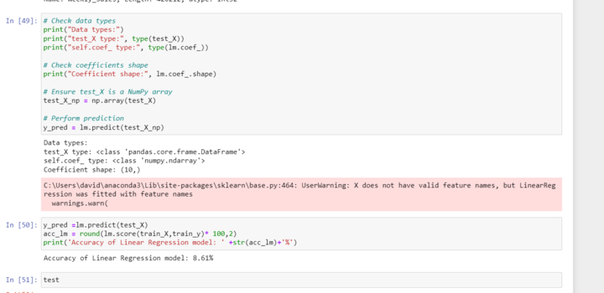
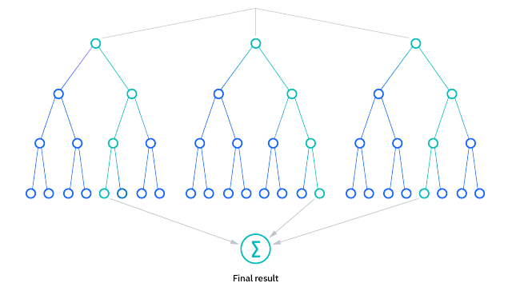
Linear Regression vs. Random Forest
Notes:
David

Slide 19
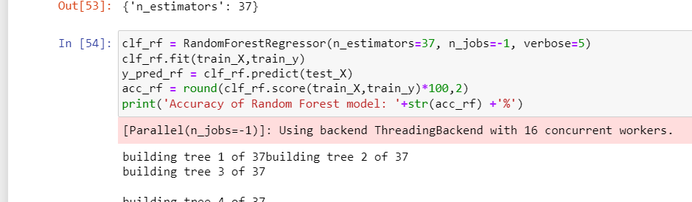
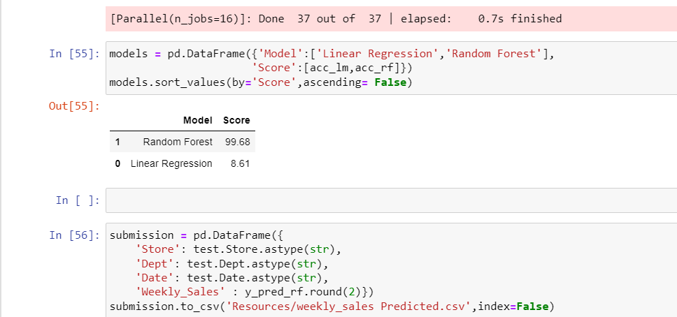
Linear Regression vs. Random Forest
Notes:
David

Slide 20
“Those who remember the past…
can, with absolute certainty, predict the future ”
- Mr. Santayana

Slide 21

Future Projected
Sales

Slide 22

Interactive
User
Website
Notes:
Tyler

Slide 23

Final point
Notes:
Erica

Slide 24

Final point
If someone invites you to go shopping on Black Friday,
JUST DON’T!

Slide 25

Thank you!

